Slide 1
Lending Club Case Study
Data analysis and Conclusions
Contribution: Ashish Kumar Sharma Swamy Satish Patil

Slide 2
Objective:
Analyze the provided dataset to identify variables that are indicators of a loan default
Identify any patterns that may exist in the dataset between the loan_status variable and any of the other variables

Slide 3
Data Understanding and Data Cleaning
Remove Columns which have more than 90% Null Values
Remove Unwanted Columns
Fill Null Values in Columns with appropriate values if applicable using data understanding
Drop some rows having Null values if can’t fill with appropriate value
Convert Data Type to Numeric wherever applicable
Examine Outliers for numeric columns using Box Plot

Slide 4
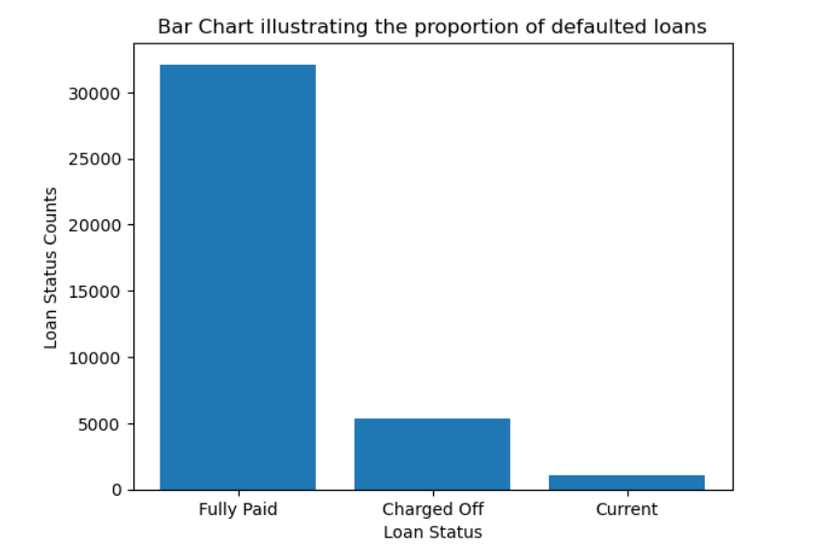
Finding 1: Proportion of charged off loan is14 %

Slide 5
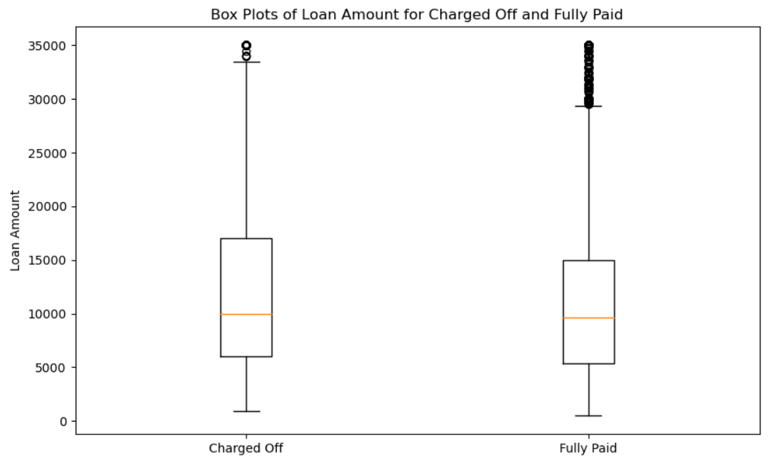
Finding 2: There is no relation with respect to loan amount for loan defaults

Slide 6
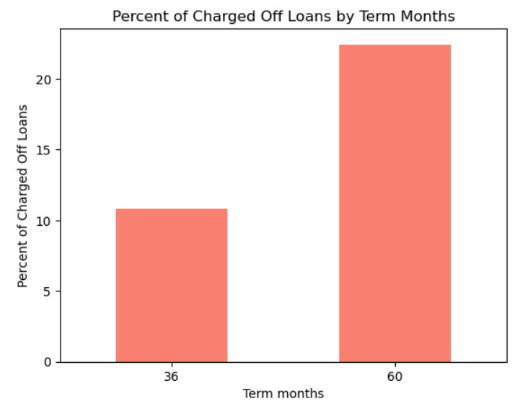
Finding 3: Likelihood of Loan Status as Charged Off is higher for Loan Term 60 months.

Slide 7
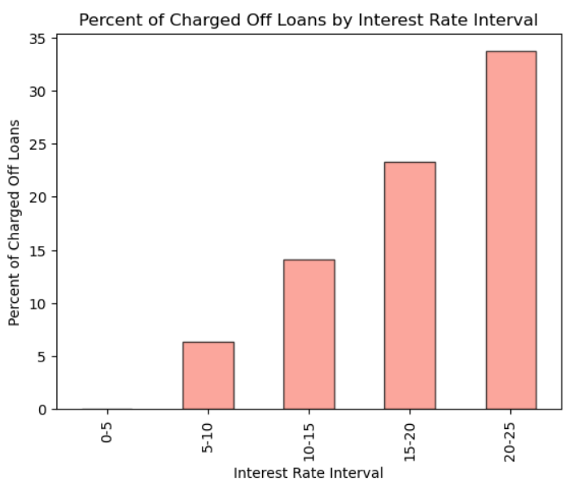
Finding 4: Interest Rates is a strong indicator of loan defaults . Higher the interest Rate , higher is the chance of loan default

Slide 8
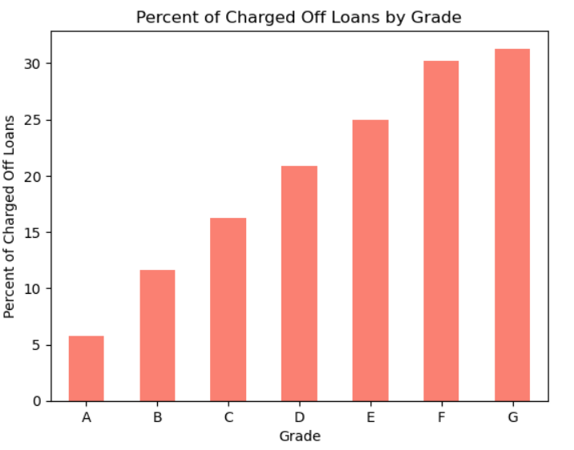
Finding 5: Grade is a strong indicator of loan default. Lower Grades have higher chances of loan default

Slide 9
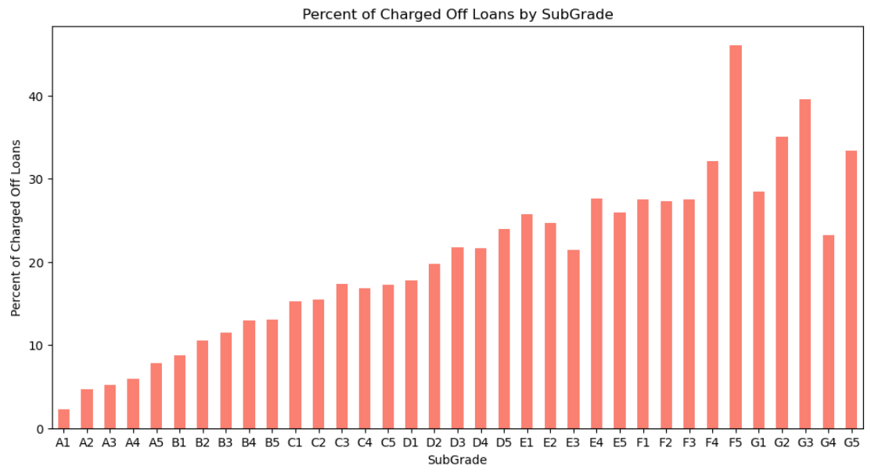
Finding 6: SubGrade is a strong indicator of loan default. Lower SubGrades have higher chances of loan default

Slide 10
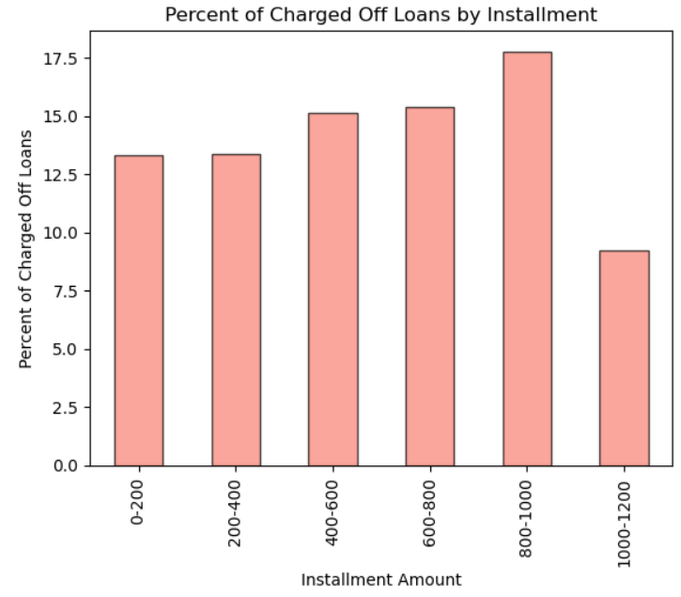
Finding 7: Likelihood of loan default increases with higher installment which can be observed when installment amount increases from 0 - 1000 but is lowered when installment amount goes above 1000

Slide 11
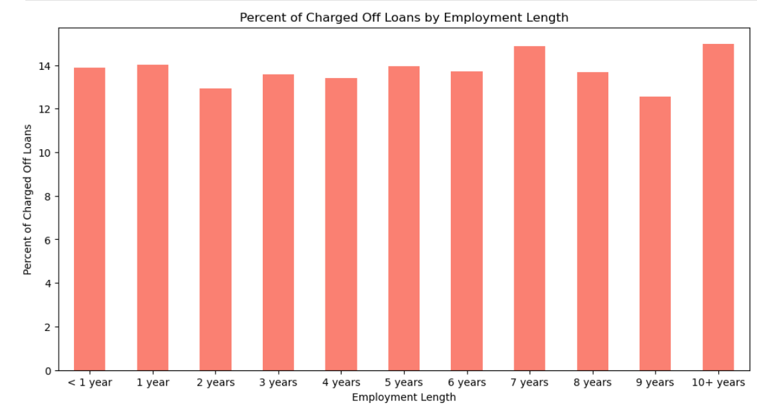
Finding 8: There is no definite trend for charged Off loans as per employment length. Employees having 7 and 10+ years of experience have slightly high rate of default.

Slide 12
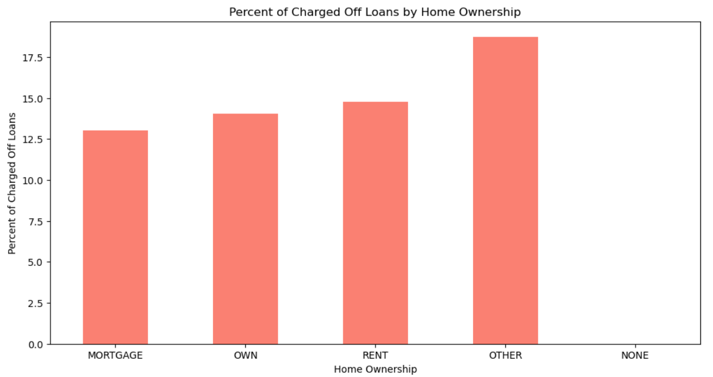
Finding 9: There is no definite trend for charged Off loans as per home ownership . Those having home ownership as other have slightly higher chances of loan default

Slide 13
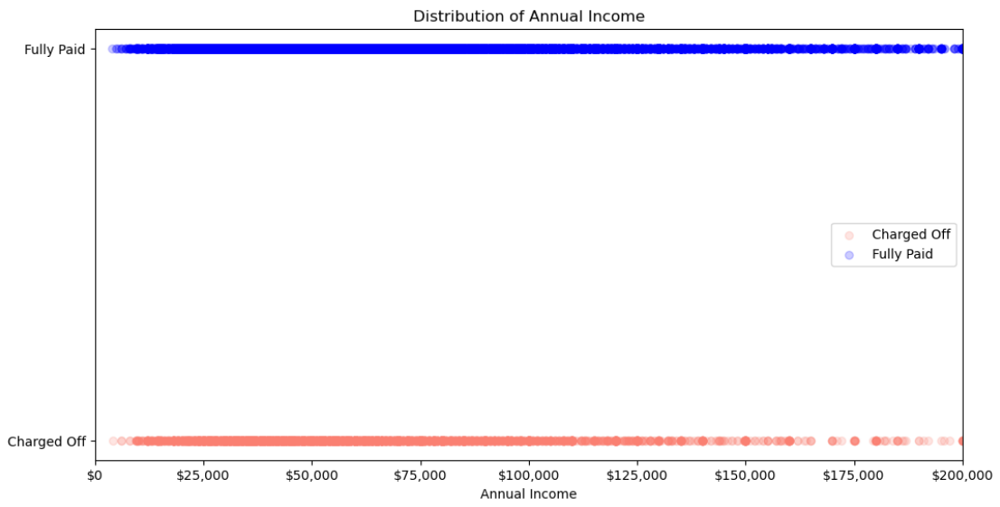
Finding 10: Charged Off Loans are more skewed towards income group below 50000.

Slide 14
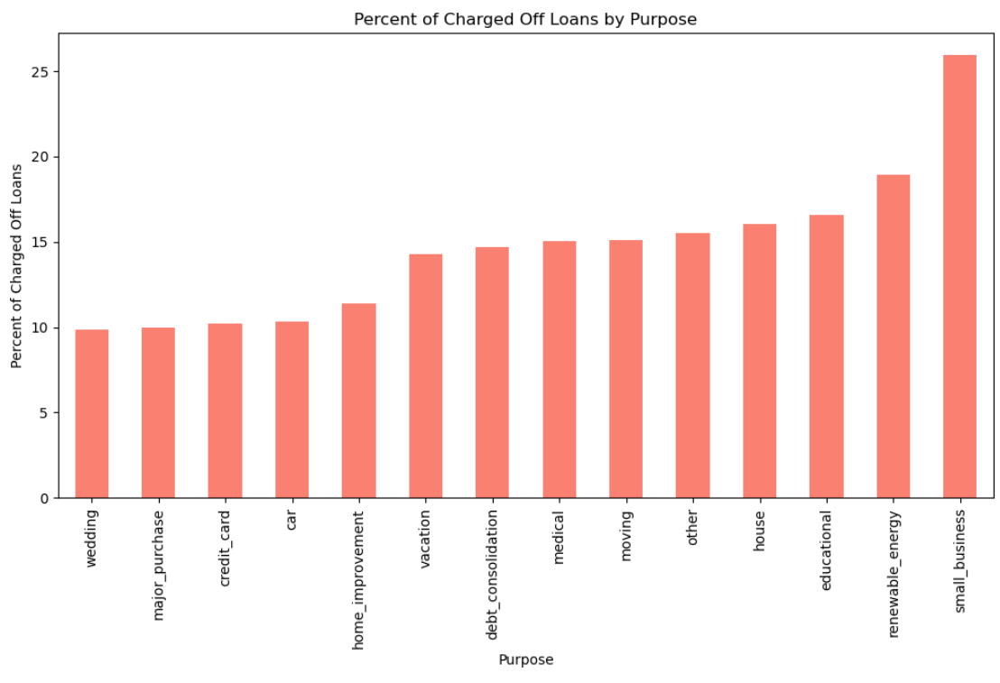
Finding 11: Purpose is a strong indicator of loan default. Some of the purposes have more bad loans

Slide 15
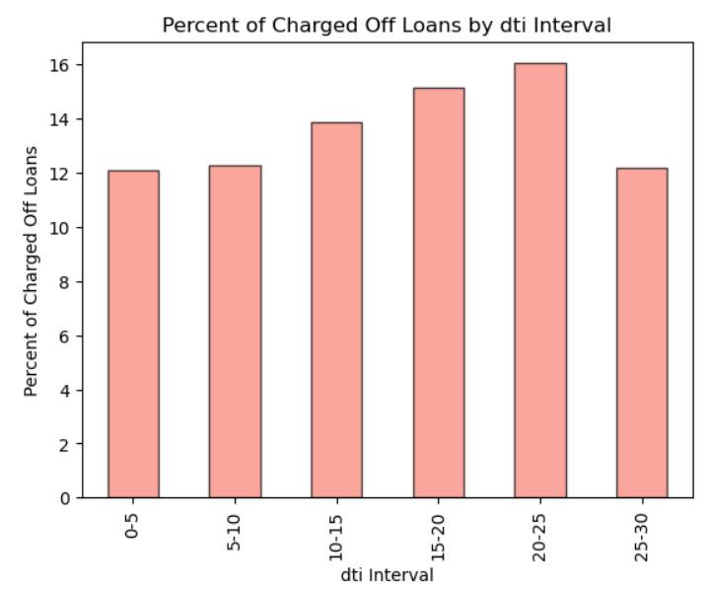
Finding 12: Likelihood of loan default increases with higher dti rate which can be observed when dti increases from 5 - 25 but is lowered when dti goes above 25

Slide 16
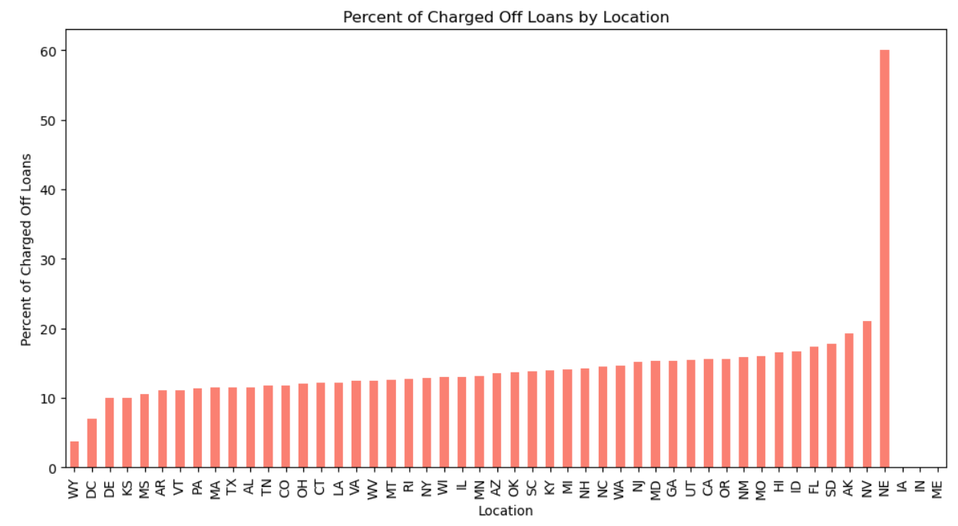
Finding 13: Some States have unexpectedly high rate of default loans such as NE(Nebraska)

Slide 17
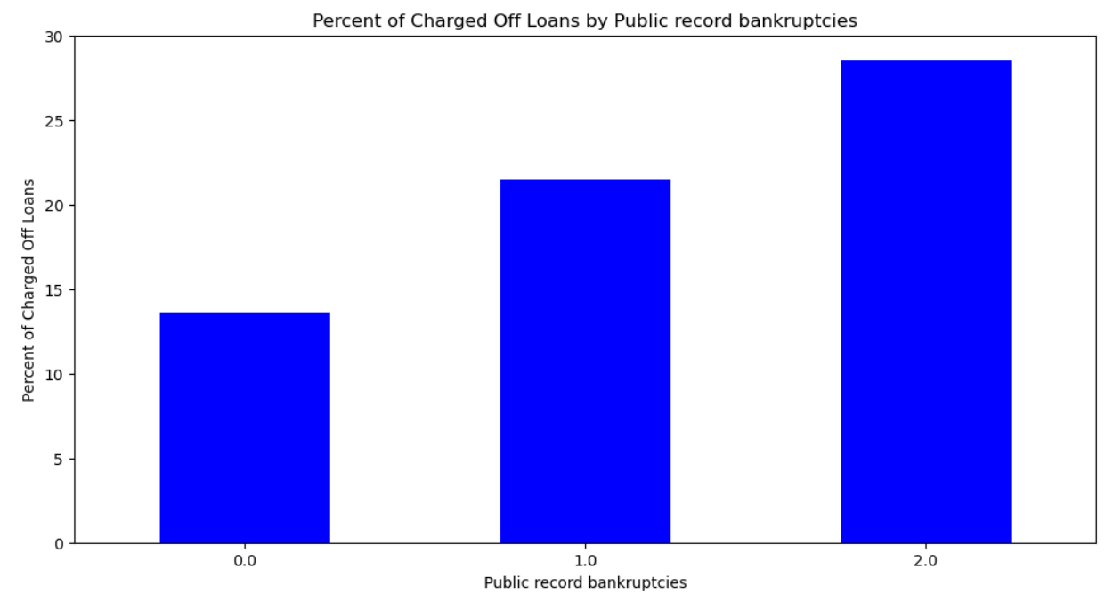
Finding 14: Public Record of Bankruptcy is a strong indicator of loan default

Slide 18
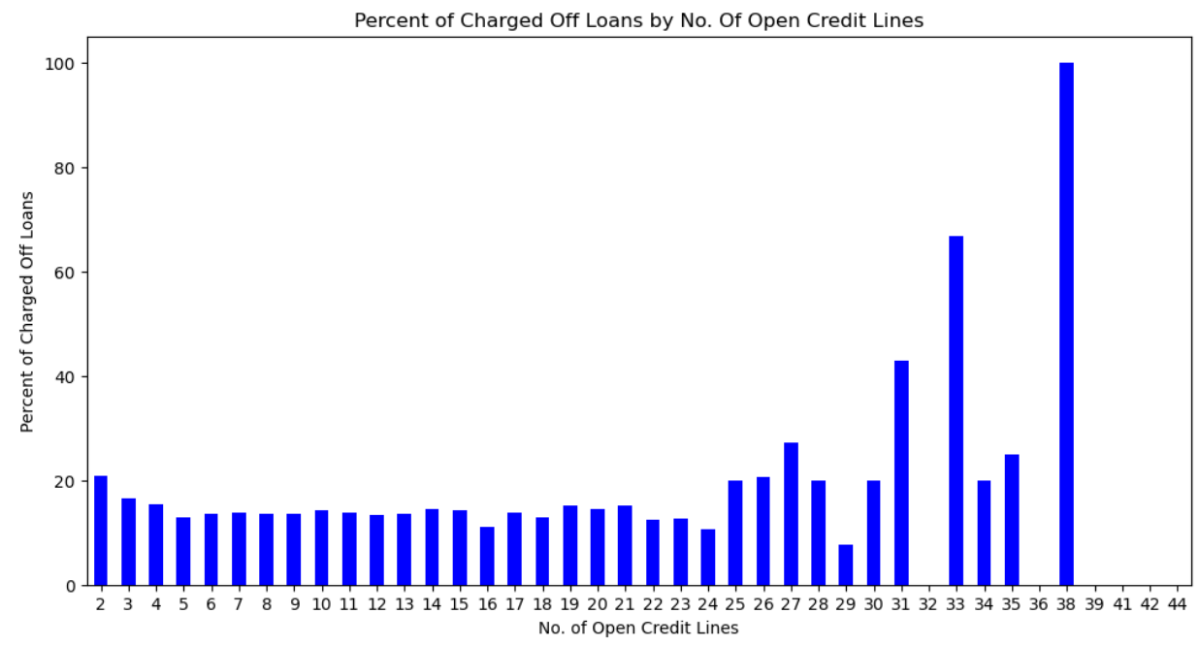
Finding 15: No. of open credit lines is a strong indicator of loan default

Slide 19
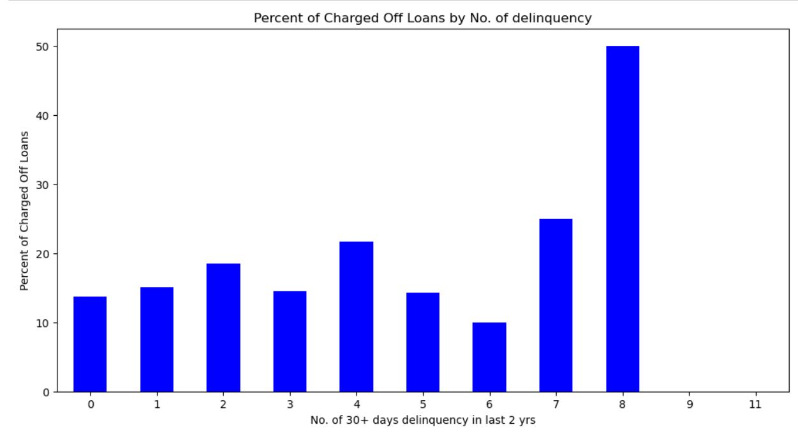
Finding 16: delinq_2yrs is a strong indicator of loan default

Slide 20
Conclusion – Strong Indicators for Loan Default
Loan Term- Loan Status as Charged Off is higher for Loan Term 60 months .
Interest Rates is a strong indicator of loan defaults . Higher the interest Rate , higher is the chance of loan default.
Grade is a strong indicator of loan default. Lower Grades have higher chances of loan default.
SubGrade is a strong indicator of loan default. Lower SubGrades have higher chances of loan default.
Likelihood of loan default increases with higher installment which can be observed when installment amount increases from 0 - 1000 but is lowered when installment amount goes above 1000
Charged Off Loans are more skewed towards income group below 50000.
Purpose is a strong indicator of loan default. Some of the purposes have more percent of bad loans.
Likelihood of loan default increases with higher dti rate which can be observed when dti increases from 5 - 25 but is lowered when dti goes above 25
Some States have unexpectedly high rate of default loans such as NE(Nebraska)
Public Record of Bankruptcy is a strong indicator of loan default. Higher the number , higher is the chance of loan default
No. of open credit lines is a strong indicator of loan default. Higher the number , higher is the chance of loan default
delinq_2yrs is a strong indicator of loan default . Higher the number, higher is the chance of loan default

Slide 21
Conclusion – Other Findings
Proportion of Charged Off loans is 14$.
Loan Amount is not a strong indicator of loan default.
There is no definite trend for charged Off loans as per employment length. Employees having 7 and 10+ years of experience have slightly high rate of default.
There is no definite trend for charged Off loans as per home ownership . Those having home ownership as other have slightly higher chances of loan default.

